Slide 1



Flow Separation Control on a Wall Mounted Hump using Discrete Flow Actuation
Colin Figgins
Mechanical Engineering Undergraduate
Jesse Little
Assistant Professor of Aerospace and Mechanical Engineering
Dr. Rene Woszidlo, David Borgmann, Arth Pande
Notes:
Add dept and funding info (Boeing), see other title slides for an example (ray)

Slide 2
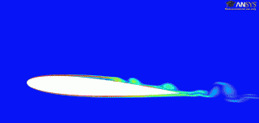
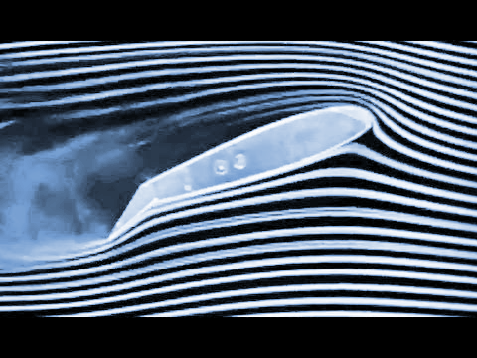
Introduction
Types of Drag
  Skin Friction and Pressure Drag
Flow Separation leads to loss of lift and increase in drag
Active vs. Passive Flow Control
https://m-selig.ae.illinois.edu/ads/coord_database.html
http://web.mit.edu/hml/ncfmf.html
Notes:
You need to cite these

Slide 3
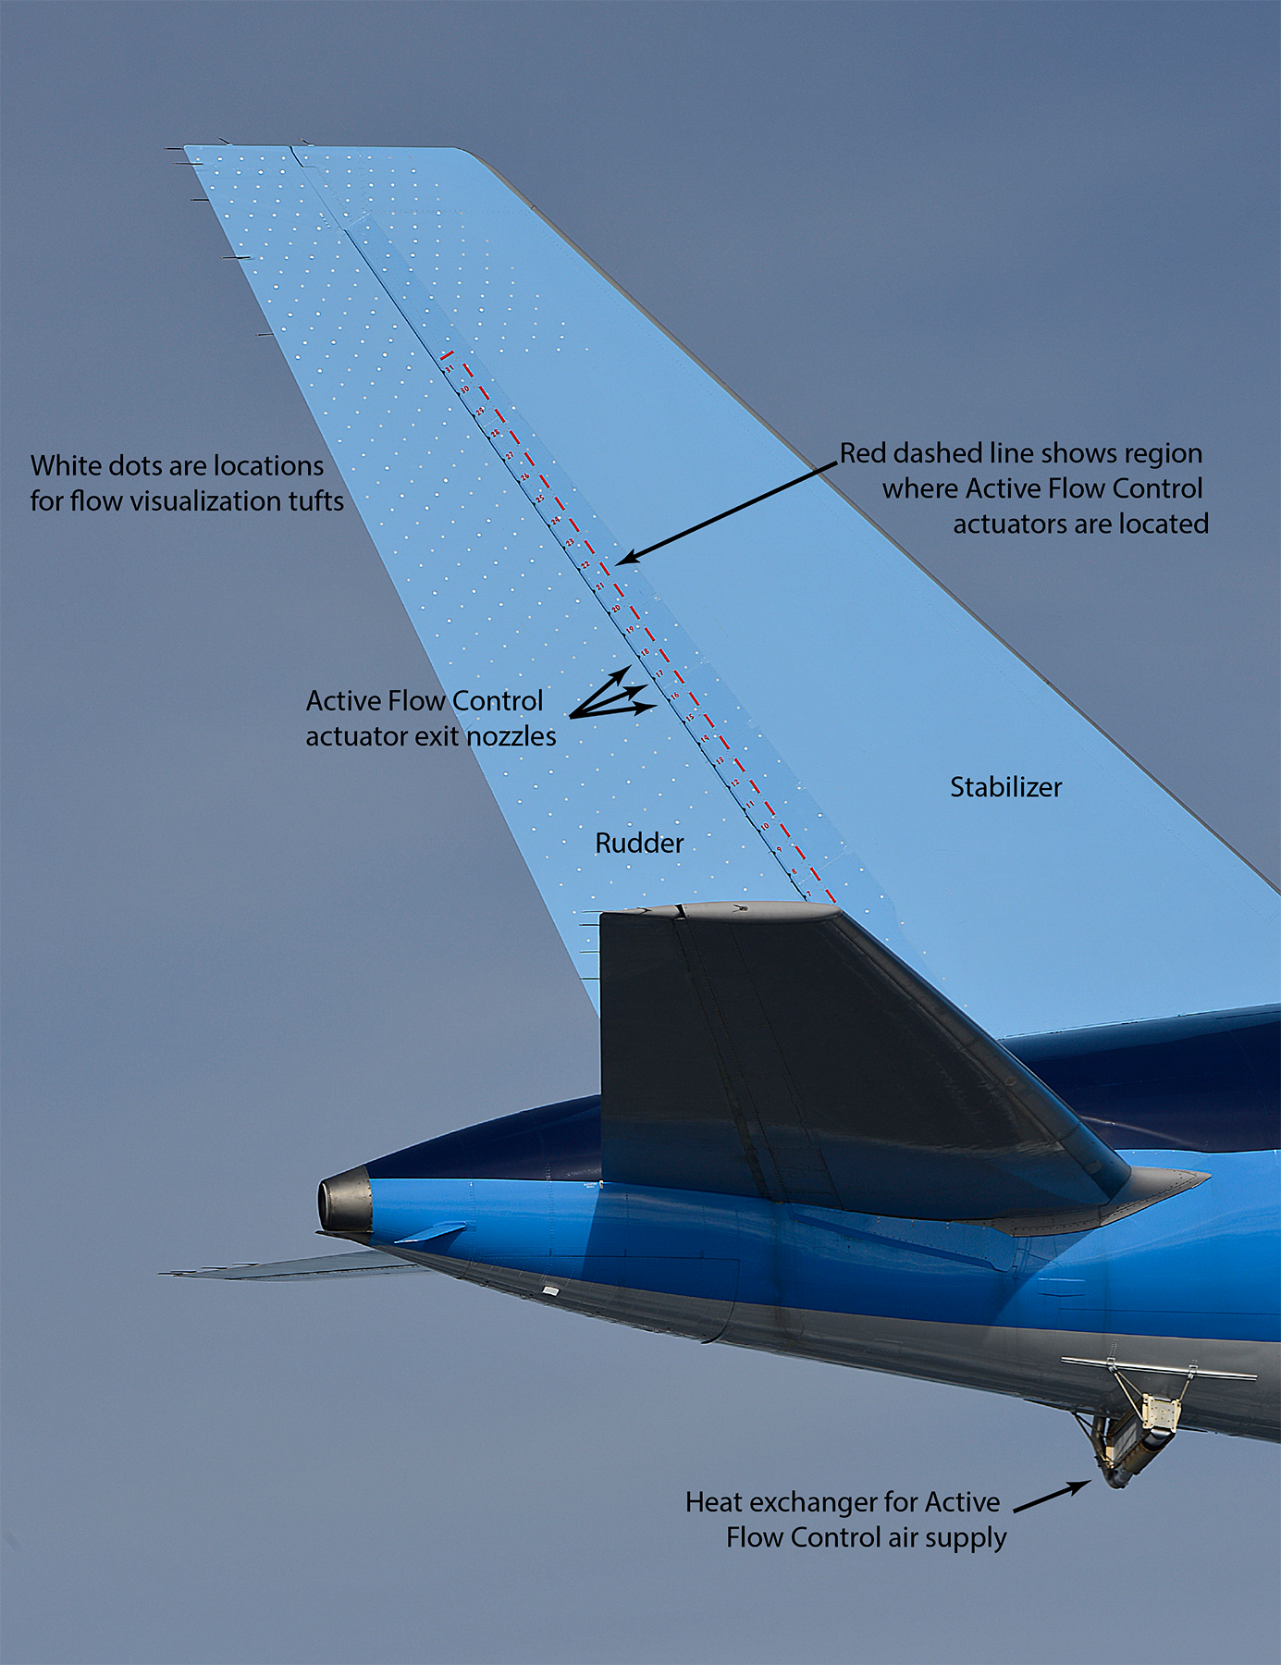
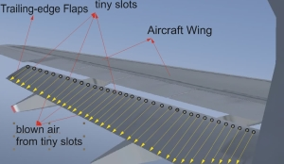
Active Flow Control Uses
http://www.dlr.de/ft/en/desktopdefault.aspx/tabid-1360/1856_read-36222/
CleanSky
Smart Fixed Wing Aircraft
https://www.nasa.gov/aero/nasa-tests-green-aviation-technology-on-boeing-ecodemonstrator.html
NASA 757 ecoDemonstrator
Notes:
Need to cite
Nice, but have more----could be a good motivation slide

Slide 4
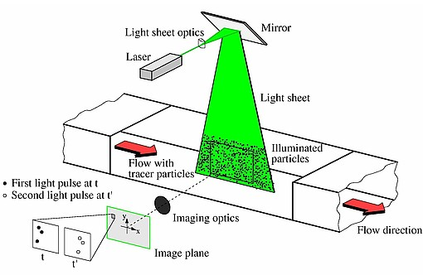
Experimental Methods
Data Acquisition Methods
Pressure Taps
  Determine
  pressure drag
Particle Image
Velocimetry
  Determine
  flow characteristics
http://aim2.dlr.de/measurement-techniques/particle-image-velocimetry-piv/index.html
Notes:
Need to cite
Create a SW file with plane of PIV

Slide 5
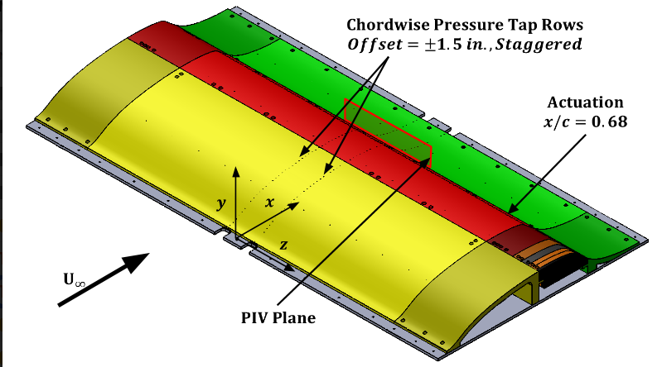
Experimental Setup
Type II Glauert-Glass Airfoil Model
Notes:
Take time to explain, see scitech ppt for info

Slide 6
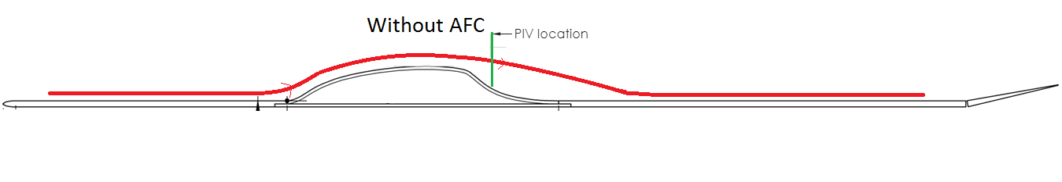
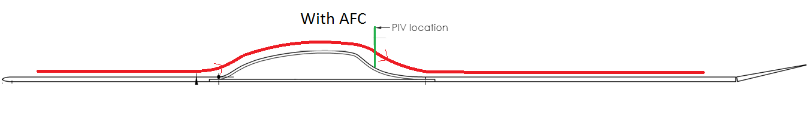
Experimental Setup

Slide 7
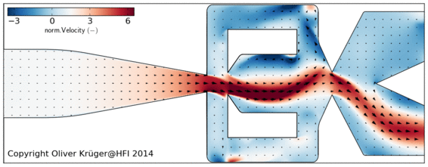
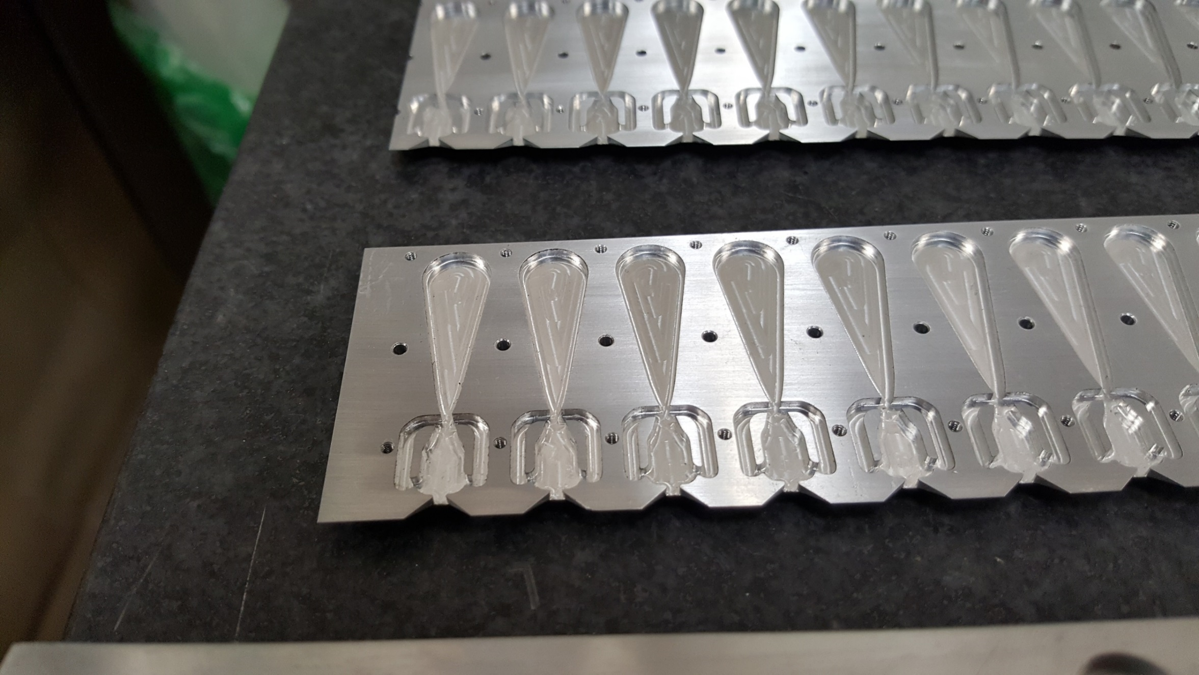
Experimental Setup
http://fd.tu-berlin.de/en/research/projects/flow-control/fluidics/
Fluidic Oscillators
More consistent than straight, steady jets
Brings in more momentum from the free stream
Notes:
Need to cite
Need to explain where this is on the model, a picture of the actuators would be nice, we have some from other ppts

Slide 8
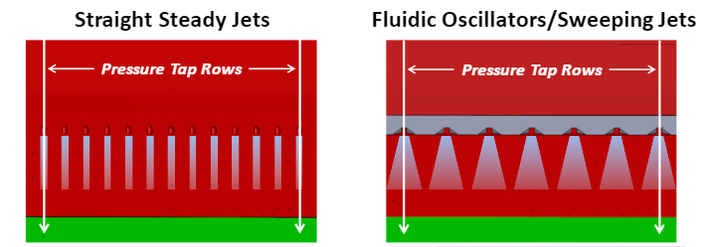
Experimental Setup
Feasibility of
Fluidic Oscillators
Brings more momentum into the boundary layer
More complicated and costly to manufacture

Slide 9
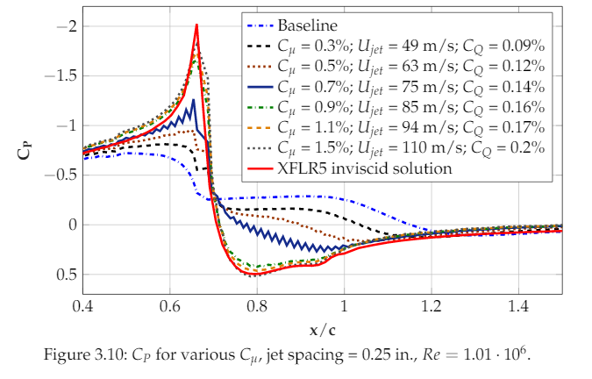
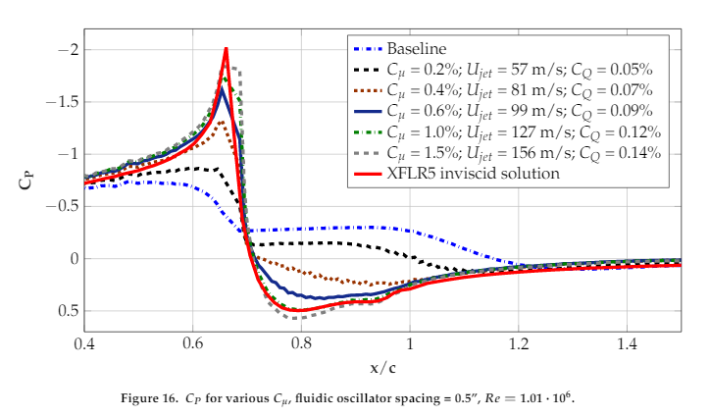
Pressure Data Results
Experimental Study of Discrete Jet Forcing for Flow Separation Control On a Wall Mounted Hump
David Borgmann
Steady Jets
Fluidic Oscillators
Notes:
Cite david’s paper, what do these variables mean??? Must explain to audience
will need to explain these curves a lot! Need to explain all these parameters.

Slide 10
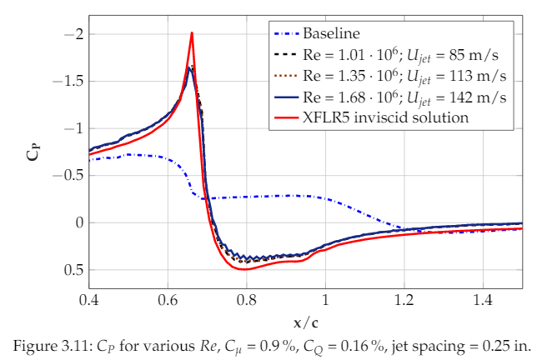
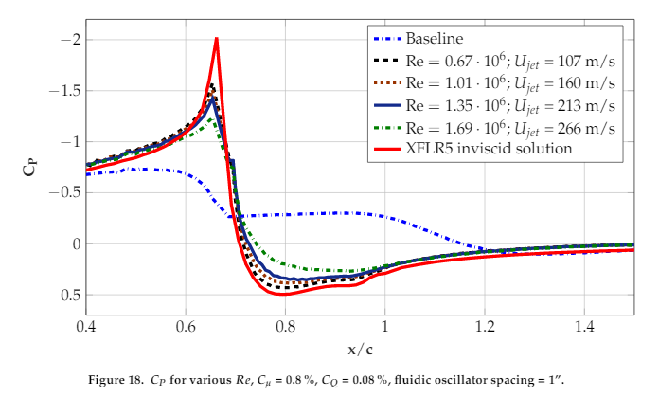
Pressure Data Results
Experimental Study of Discrete Jet Forcing for Flow Separation Control On a Wall Mounted Hump
David Borgmann
Steady Jets
Fluidic Oscillators

Slide 11
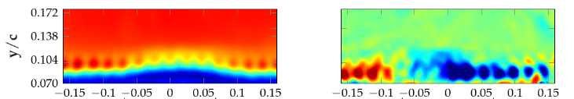
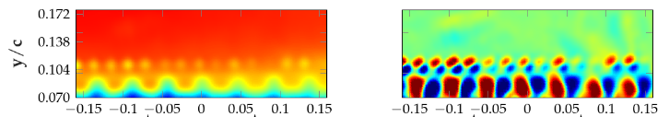
PIV Results
Steady Jets
Experimental Study of Discrete Jet Forcing for Flow Separation Control On a Wall Mounted Hump
David Borgmann
Fluidic Oscillators

Slide 12
Conclusions
Steady jets
reattach the flow at at small spacing
require higher jet amplitudes.
Fluidic oscillators
reattach the flow at larger spacing
require lower jet amplitudes to do so.
Consistently produces streamwise vortices
Notes:
What is the main takeaway----the sweeping motion is important since it seem to set up more coherent streamwise vortices!!

Slide 13
Acknowledgements
David Borgmann
Arth Pande
Christopher Otto
Susan Brew
Dr. Rene Woszidlo
Jesse Little
NASA Space Grant
University of Arizona
Boeing
Notes:
Dr. Rene Woszidlo
What is the main takeaway----the sweeping motion is important since it seem to set up more coherent streamwise vortices!!

Slide 14
Thank You!
Notes:
What is the main takeaway----the sweeping motion is important since it seem to set up more coherent streamwise vortices!!

